Slide 1


Medical Investigation Task Force
Draft
The Imperial College LondonCovid-19 Simulation Model
The Chaos of C by Professor Lockdown Neil Ferguson
Code Review
04/01/2020 The Original Lockdown Model Code

Slide 2


Imperial College COVID-19 Response Team
From Wikipedia, the free encyclopedia
Imperial College COVID-19 Response Team is a crisis-time scientific and advisory team set up by Imperial College London within the Faculty of Medicine to study the COVID-19 pandemic and advise the government of the United Kingdom.^{[1]} Its leader is Neil Ferguson.^{[2]}
On 16 March 2020 the COVID-19 Response Team produced a research forecast of various scenarios for spread of the disease in the United Kingdom and the United States. Without any mitigation their forecast showed local health care capabilities vastly overwhelmed by the epidemic wave. Periodic cycles of quarantine followed by softer social distancing were recommended, with quarantines in effect two thirds of the time.^{[3]} On 30 March, a study on 11 European countries was published.^{[4]} It provided estimates of the situation as of 28 March (observed and modelised), and projections for 31 March given current expectations, no action, and the difference. It also provided a list of government policies and their respective absolute dates.^{[4]} As of 20 May, the COVID-19 Response Team has produced 22 reports.^{[5]}
Follow us on Github for Updates all around the Lockdown on an Interdisciplinary view about the SARS-Cov-2 and Covid-19 Topic

Slide 3
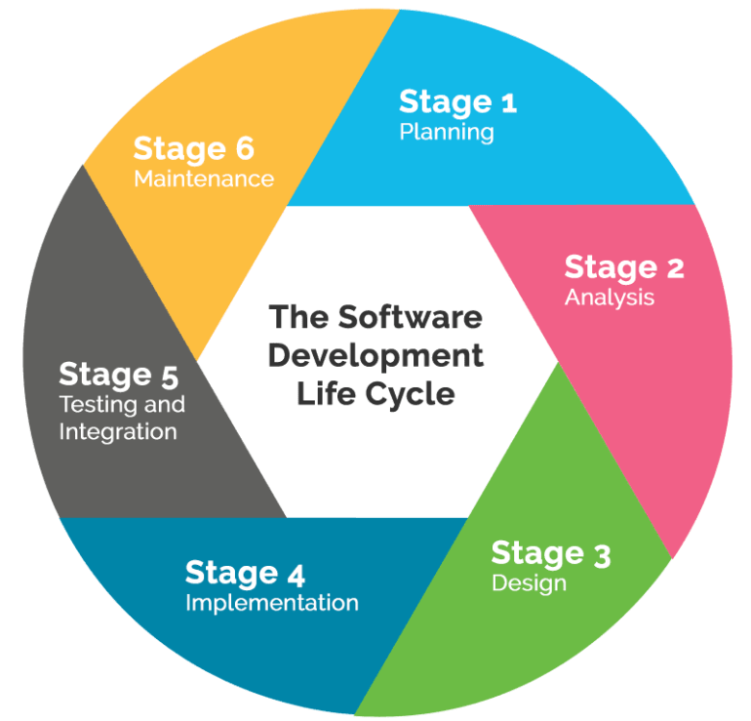
What was wrong in your Code?
Chuck Norris can divide by zero, but you are not Chuck Norris ! ☺
Chuck Norris can handle Threads without a Scheduler ….

Slide 4

SpatialSim.cpp
Lines:4661
Cyclomatic Complexity:1334
Decision Density:0.29
Shapes:5953
Links:7194

Slide 66
Sweep.cpp
Lines:1566
Cyclomatic Complexity:321
Decision Density:0.20
Shapes:1480
Links:1770

Slide 82
Update.cpp
Lines:1283
Cyclomatic Complexity:258
Decision Density:0.20
Shapes:1231
Links:1462

Slide 109
Rand.cpp
Lines:2416
Cyclomatic Complexity:204
Decision Density:0.08
Shapes:1111
Links:1290

Slide 133
Update.cpp
Lines:1283
Cyclomatic Complexity:258
Decision Density:0.20
Shapes:1231
Links:1462

Slide 160
Sweep.cpp
Lines:1566
Cyclomatic Complexity:321
Decision Density:0.20
Shapes:1480
Links:1770

Slide 176
SetupModel.cpp
Lines:2618
Cyclomatic Complexity:634
Decision Density:0.24
Shapes:2823
Links:3409

Slide 177
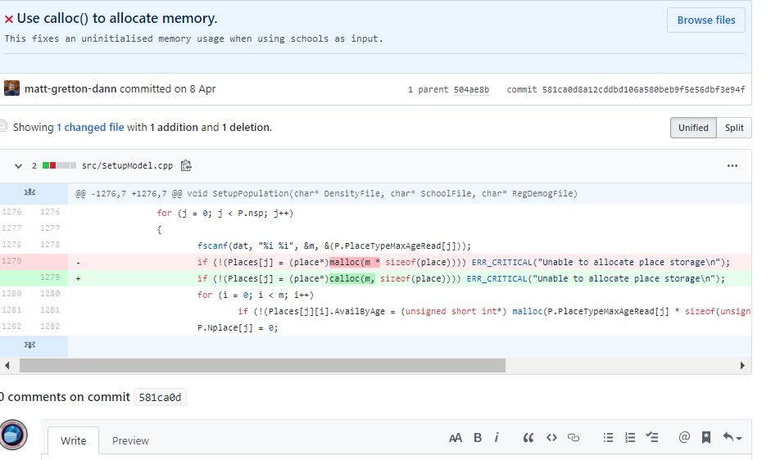
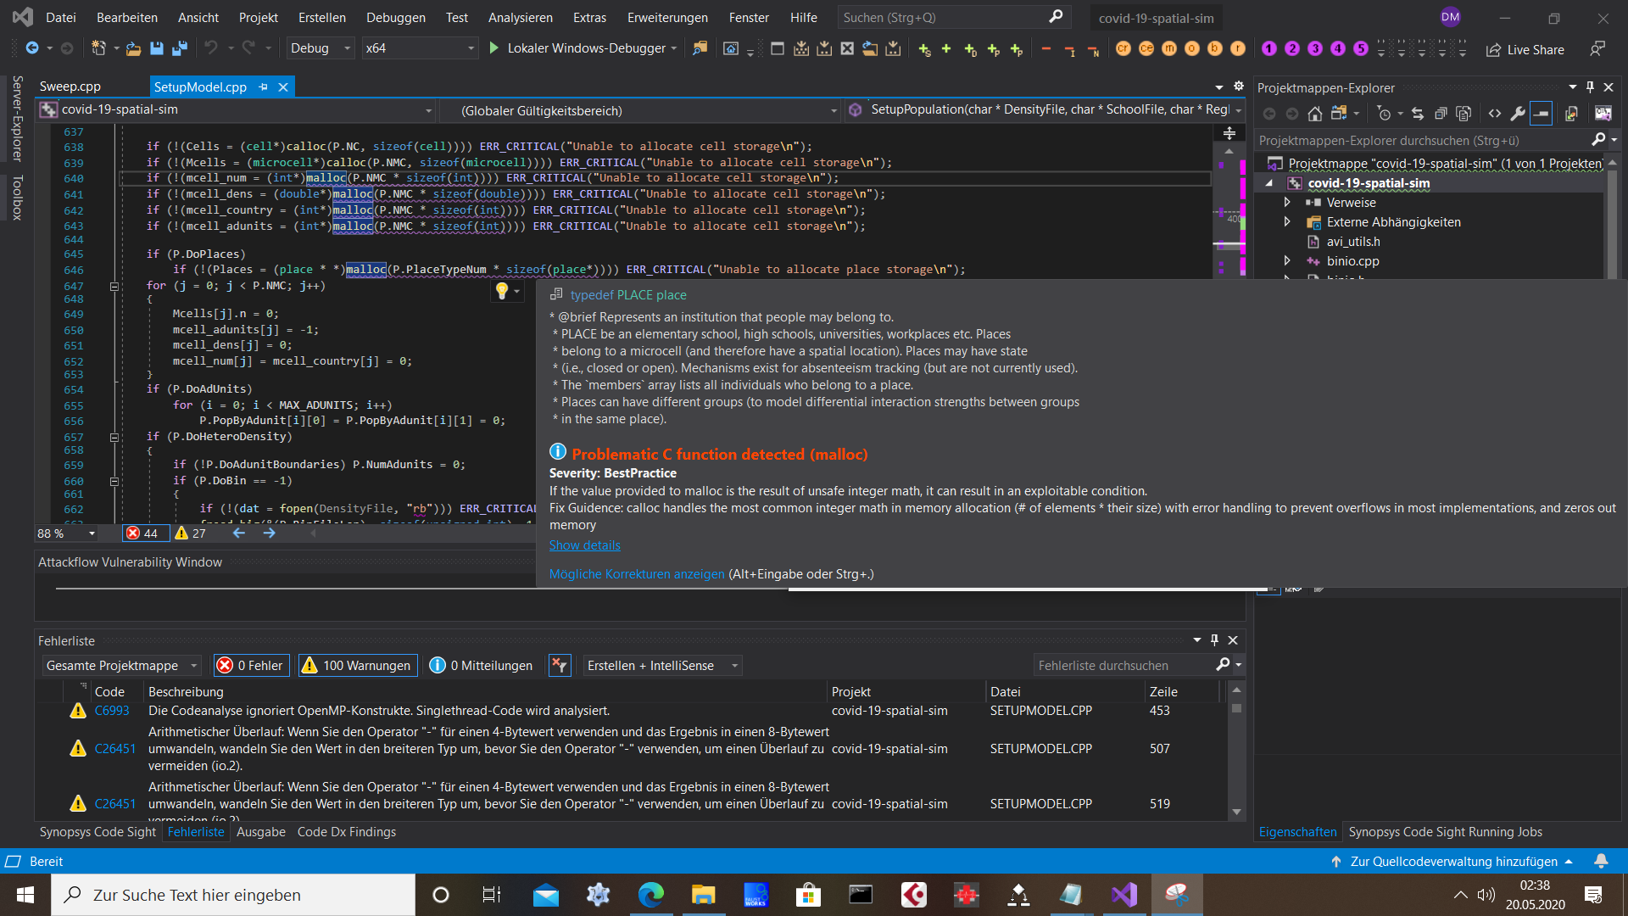
Using C in C++ is Bad!

Slide 208
Kernels.cpp
Lines:122
Cyclomatic Complexity:13
Decision Density:0.11
Shapes:98
Links:100

Slide 219
Dist.cpp
Lines:193
Cyclomatic Complexity:38
Decision Density:0.20
Shapes:160
Links:190

Slide 227
binio.cpp
Lines:164
Cyclomatic Complexity:3
Decision Density:0.02
Shapes:31
Links:29

Slide 232
Bitmap.cpp
Lines:302
Cyclomatic Complexity:48
Decision Density:0.16
Shapes:274
Links:317

Slide 237
CalcInfSusc.cpp
Lines:74
Cyclomatic Complexity:1
Decision Density:0.01
Shapes:36
Links:28

Slide 246
Error.cpp
Lines:14
Cyclomatic Complexity:1
Decision Density:0.07
Shapes:5
Links:4

Slide 248
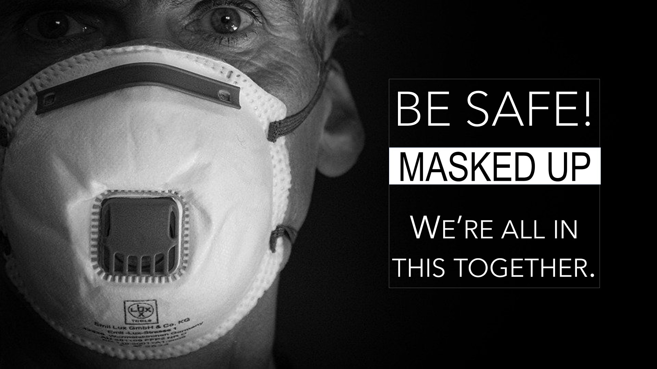
The End

